Slide 1
Shale oil and gas reservoir characterisation
Presentation of IPGC,
2 of September 2015
Giza, Egypt
Alexander Repnik

Slide 2
Outline of the project
0
Objectives & Project highlights
1
The initial evaluation of potential of shale oil and gas basins
2
Unconventionals pore system
3
Shale reservoir properties (selection criteria's)
4
Well space unconventional reservoir characterisation
5
3D space unconventional reservoir characterisation
6
Defining completion strategy
7
Reserves and uncertainty analysis
8
Conclusion and future opportunities of investigation
1
Outline
Shale plays
Basin potential
Well space characterisation
3D space characterisation
Reserves and uncertainty
Conclusion

Slide 3
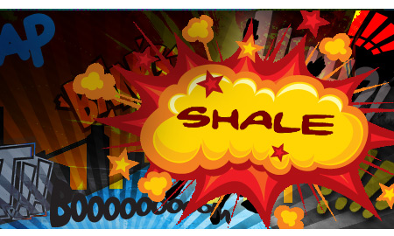
Objectives & Project Highlights
1
Study approach about initial evaluation of potential shale oil and gas basins
2
Study unconventional pore system and reservoir properties of shale plays
3
Developing an integrated approach for reservoir characterisation in well space and 3D domain
4
Construction of integrated reservoir model for reserves and uncertainty analysis
2
Objectives
Shale plays
Basin potential
Well space characterisation
3D space characterisation
Reserves and uncertainty
Conclusion

Slide 4
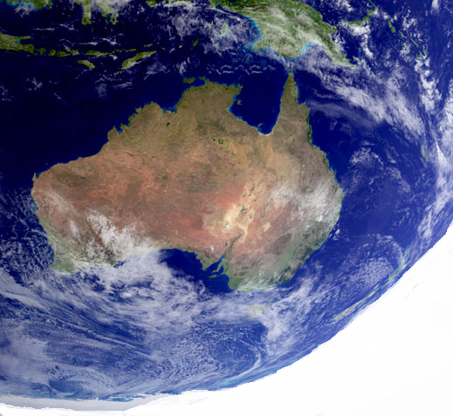
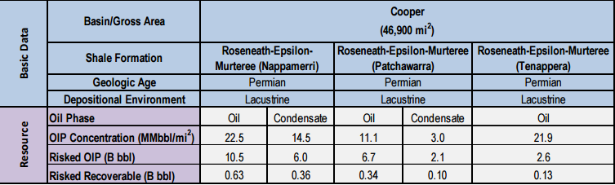
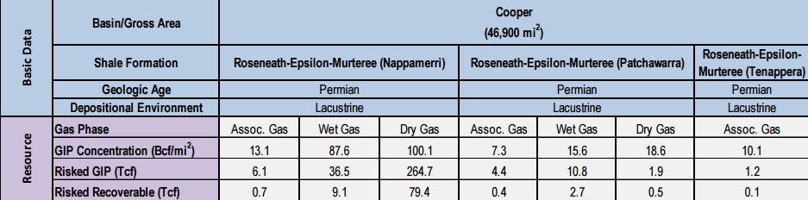
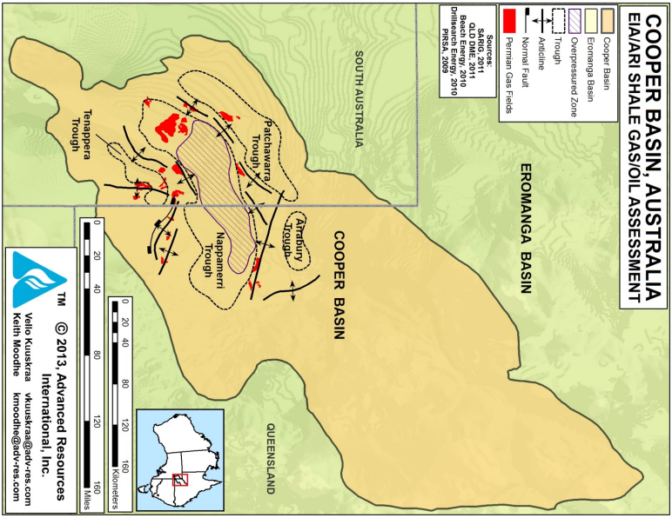
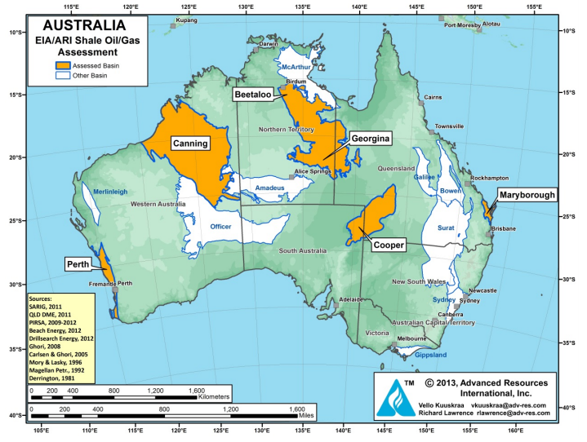
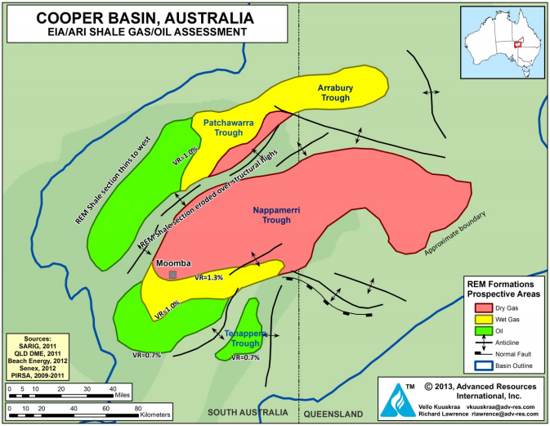

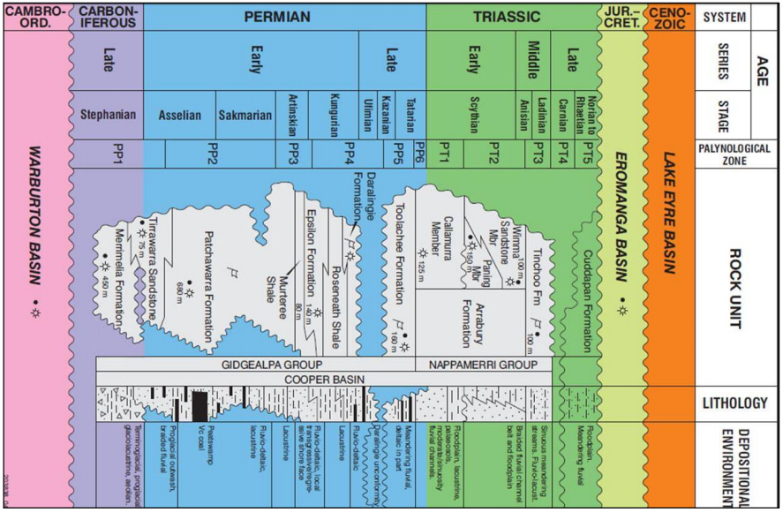
Looking to Hunt,MMmm !
As a result
Unique combination of subsurface temperature conditions, pressure, amount and level of maturity of organic matter.
An initial evaluation of potential of shale oil and gas basins
Low geological risks
1
The selection of region for future evaluation based on strategy of company and market gsituation
Murteree-Epsilon
Shale Formations
Permian Sedimentation
Fluvial, Marine sediments
The strong influence of diagenesis on the mineral composition
The high thermal gradient
Overpressure
Depth: 2500-3000 m
Temperature: ~ 150-200 ° C
Shale Thickness > 45 m
Average TOC 2%
High temperature and pressure leads to higher plasticity species that affects the determination of horizontal wells
2
Preliminary geologic and reservoir characterization of shale basins and formation(s)
3
Evaluation of the areal extent of the shale formation(s)
4
Defining the prospective area for each shale gas and shale oil formations.
5
Estimating the Resource
6
Recoverable factors
7
Estimating the Technically Recoverable Resource
3
Outline
Shale plays
Basin potential
Well space characterisation
3D space characterisation
Reserves and uncertainty
Conclusion

Slide 5
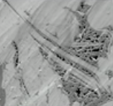
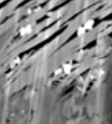

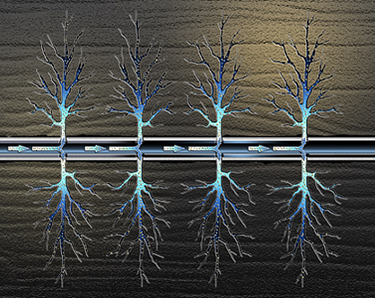
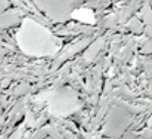
The unconventionals pore system
Not connection
Post deposition influence
Pores are too small
Processes of maturation of TOC
Opened pores by mineralization
Fracturing are need
to produced oil and gas
Deposition
influence
Composite system
Integrain pore system
Hydrocarbons
4
Outline
Shale plays
Basin potential
Well space characterisation
3D space characterisation
Reserves and uncertainty
Conclusion

Slide 6

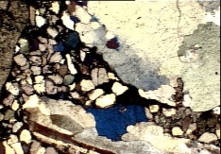
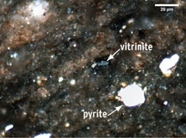
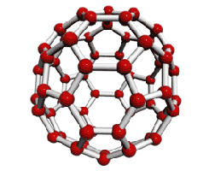

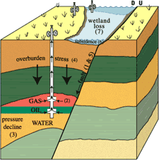
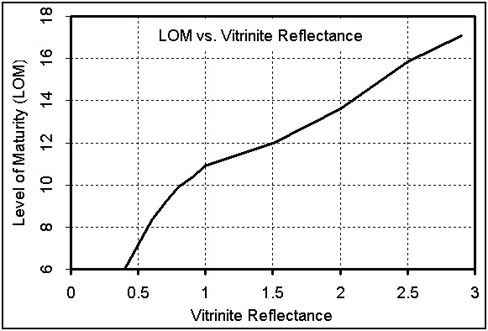
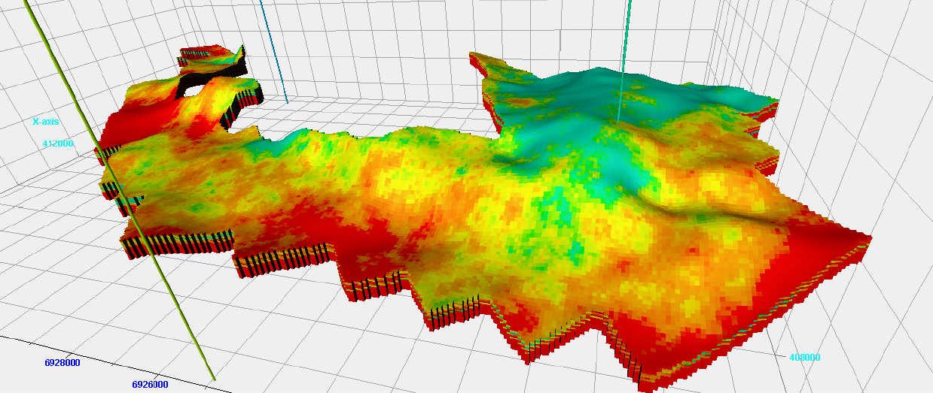
Description of shale play properties
Shale Reservoir Properties
Geological
Geochemical
Geomechanical
Radioactivity
Mineralogy
Vitrinite reflectance
Total Organic Carbon
T max
Catagenesis
Gradation
LOM
Brittleness
Well logs
Core analysis
Basin modeling
Well calculations
Basin modeling
Catagenesis modeling
Calculation from well logs
Seismic techniques
High
Most Quartz
>1 %
>1%
> 350 C
Middle or main
> 13
> 75%
Shale play identification
5
Outline
Shale plays
Basin potential
Well space characterisation
3D space characterisation
Reserves and uncertainty
Conclusion

Slide 7
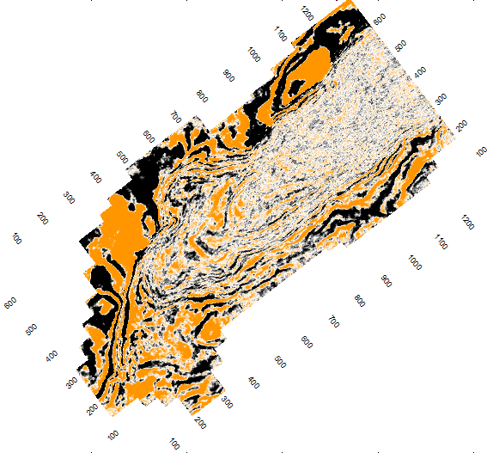
Dataset for investigation
Seismic survey
Survey:Bin 12.5 on 25,Number of Inlines 1326,Number of Crosslines 707
Post stack data
2 wells
Well 1: logging tools, geochemistry data
Well 2: logging tools,geochemistry data
Gamma ray
Density
Sonic
Deep Resistivity
Spontaneous Potential
Composite Log
Mud Log
Completion Report
Time-Depth data
Seismic/Sonic Calibration
Gamma ray
Sonic
Composite Log
Mud Log
Completion Report
Time-Depth data
Seismic/Sonic Calibration
Well 1
Well 2
6
Outline
Shale plays
Basin potential
Well space characterisation
3D space characterisation
Reserves and uncertainty
Conclusion

Slide 8
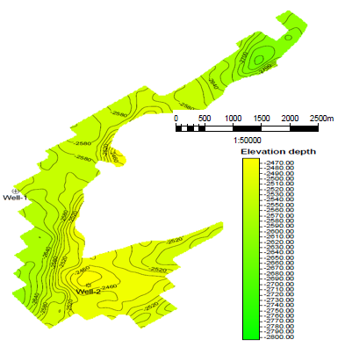
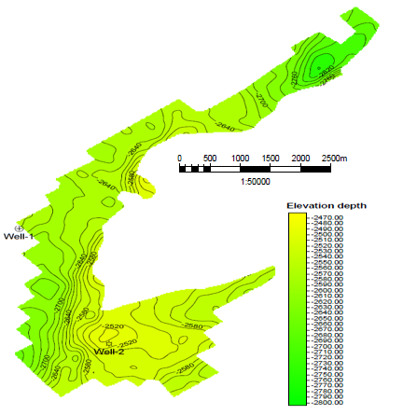
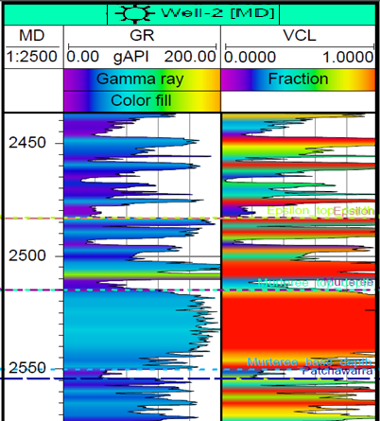
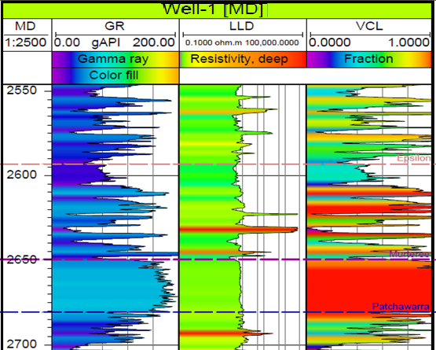
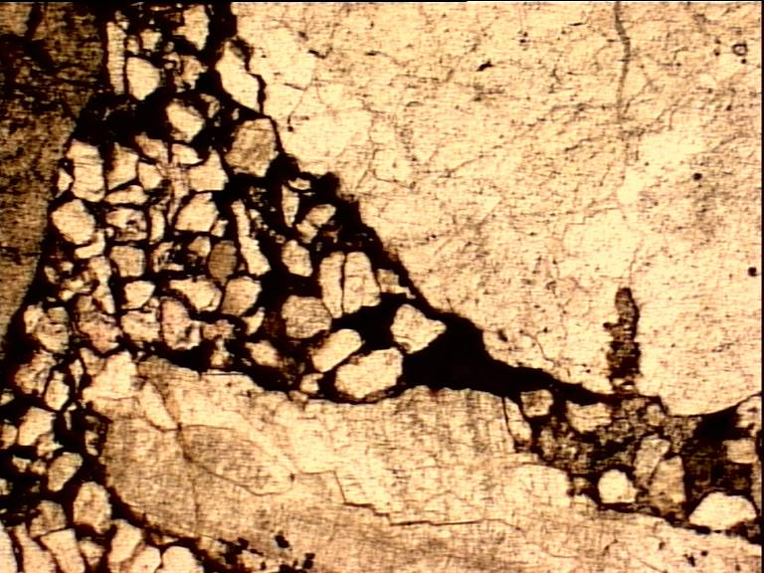
Initial geophysical and formation evaluation study of Murteree-Epsilon formations
Depth map Epsilon Formation
Depth map Murteree Formation
Well logging study
Analysis of thin sections Murteree Formation
Quartz minerals
Organic material's
7
Outline
Shale plays
Basin potential
Well space characterisation
3D space characterisation
Reserves and uncertainty
Conclusion

Slide 9
Well space unconventional reservoir characterisation
Well Space Reservoir Characterisation
Geochemical
Geomechanical
Well logging data
Visual TOC prediction, DTvsDT_R analysis
Estimation Poisson ratio and Young modulus
Rock-physics
analysis
If DT > Dt_R
Yes
Passey TOC estimation and calibration with lab data
Brittleness analysis
If Ibr > 75 %
Yes
If TOC >1
Yes
Finding relation between geochemical, geomechanical and seismic domain
Places for horizontal drilling to frac in potential zones
Maturity analysis in according of vitrinite reflectance value analysis
Completion strategy determination
If VR0>1
Yes
Potential zone identification
Reserves estimation and uncertainty analysis
8
Outline
Shale plays
Basin potential
Well space characterisation
3D space characterisation
Reserves and uncertainty
Conclusion

Slide 10
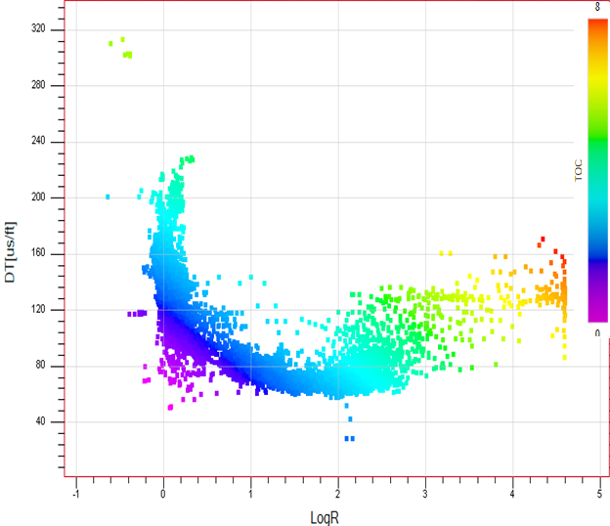
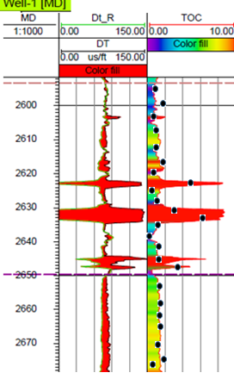
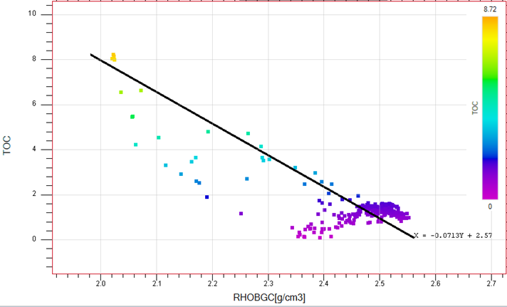
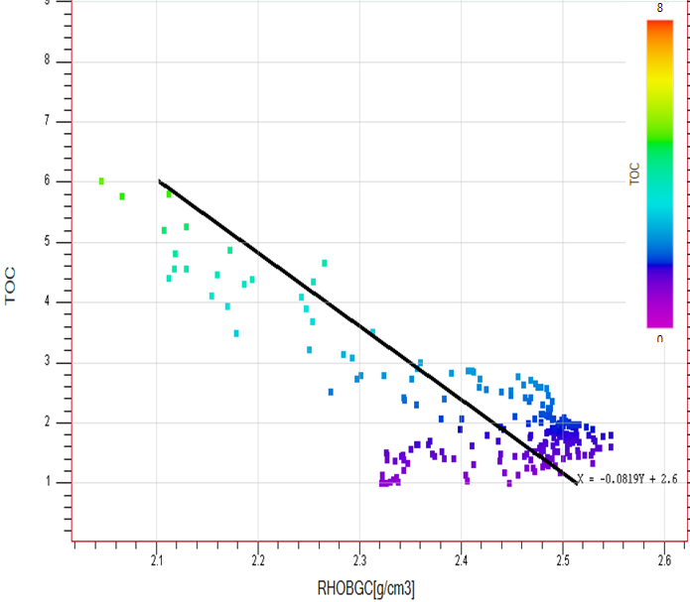
Well space-Geochemical: Visual TOC prediction, DTvsDT_R analysis, Passey TOC modified method-Well 1
1
Calculate LogR of all Resistivity logs
Determination shale play
Passey TOC
2
Creating Cross‐Plot LogR vs Sonic (DT)
Non-Shale line
DtR
Shale play
3
Determine low Resistivity Shale line
4
Calculate new Sonic (pseudo‐sonic DtR) from Shale line [DtR=b‐m*LogR]
5
Overlay pseudo‐sonic (DtR) over sonic
6
Highlight cross over of pseudo‐sonic with DT
7
Calculation TOC from resistivity data
logR = log (RESD / RESDbase) - 2.5 * (DTC – DTCbase)
8
Correlation TOC with density data
TOC = (DlogR * 10^(0.297 – 0.1688 * LOM))
Epsilon formation
Murteree formation
9
Outline
Shale plays
Basin potential
Well space characterisation
3D space characterisation
Reserves and uncertainty
Conclusion

Slide 11
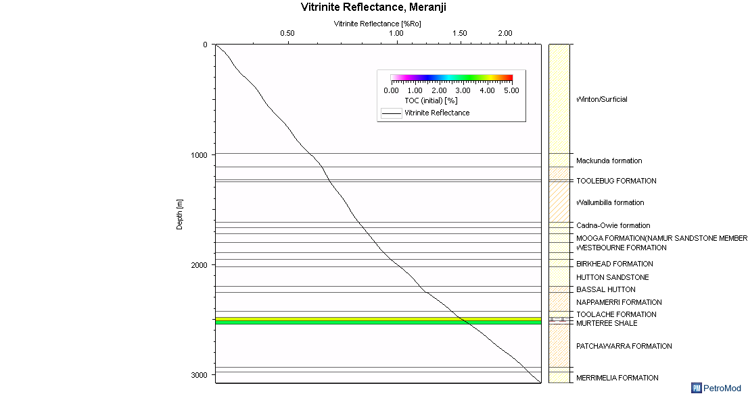
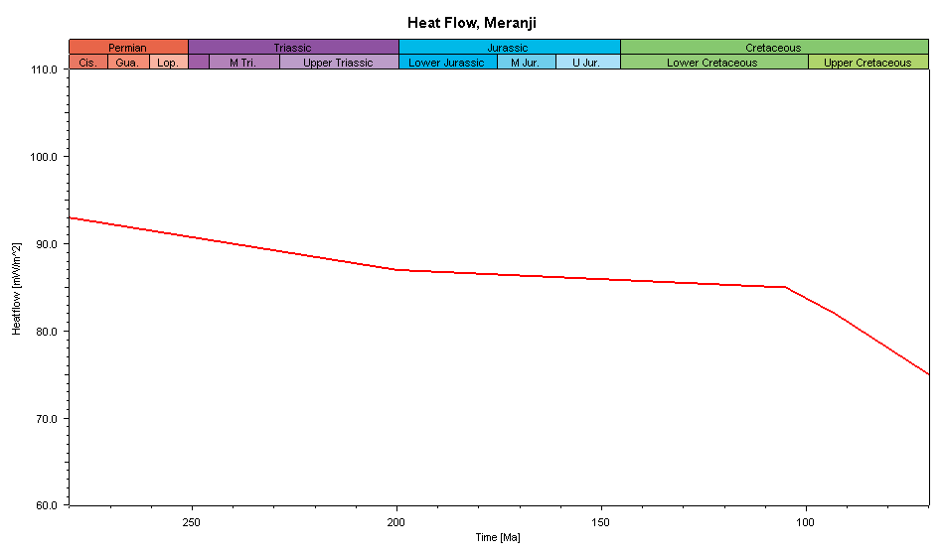
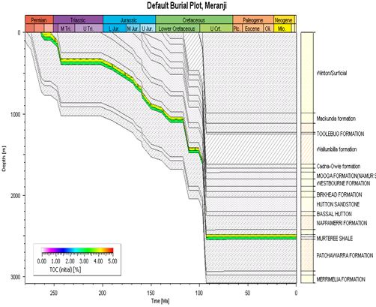
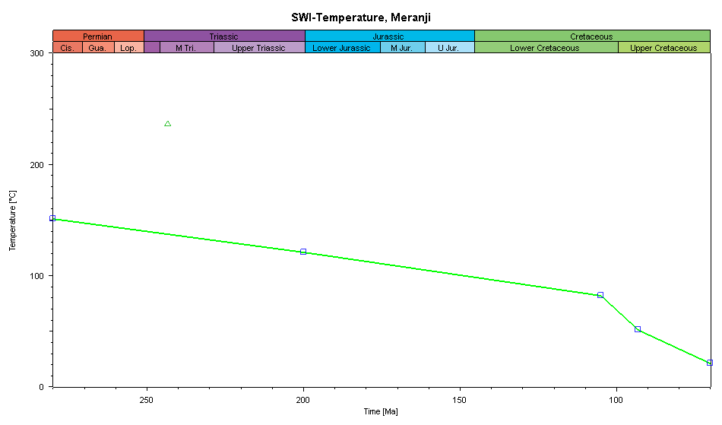

Well space - Geochemical: 1D Basin Modeling - Well 2
Basin modeling
Source
Data
Epsilon - TOC 4 %, Type Kerogen 2
Murteree -TOC 3 %, Type Kerogen 2
Vitrinite reflectance
Burial History Chart
Heat Flow
SWI-Temperature
Vitrinite reflectance changes from 1.51 to 1.57
Murteree-Epsilon Formations are dry gas zone
10
Outline
Shale plays
Basin potential
Well space characterisation
3D space characterisation
Reserves and uncertainty
Conclusion

Slide 12
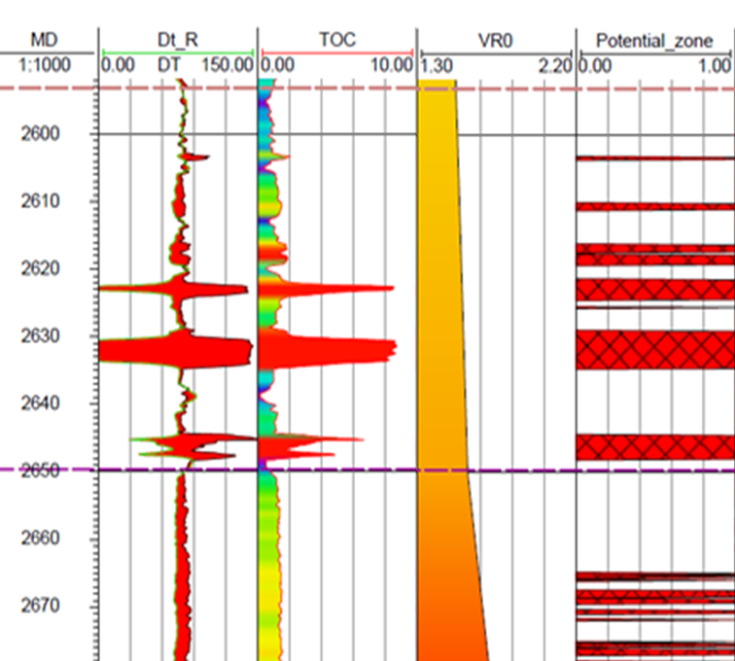
Well space - Geochemical: Potential zone identification – Well 1
Criteria selections
Overlying DT under non-shale DT
TOC > 1 %
Mature Rocks,
Vitrinite reflectance>1 %
Identification potential zones
11
Outline
Shale plays
Basin potential
Well space characterisation
3D space characterisation
Reserves and uncertainty
Conclusion

Slide 13
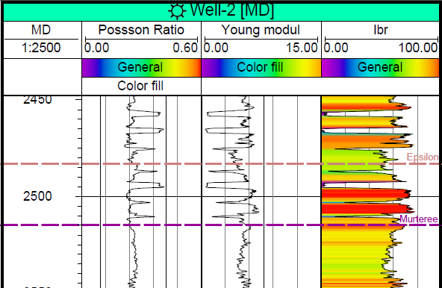
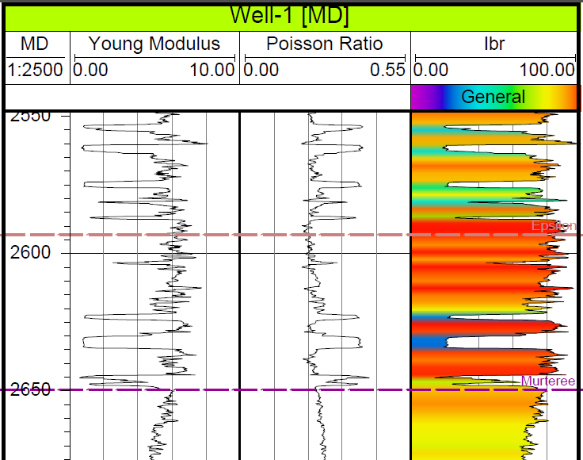
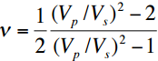
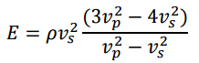
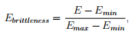
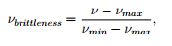
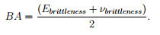
Well space - Geomechanical: Poisson ratio, Young Modulus, Average Brittleness estimations
Poisson Ratio
Poisson Ratio
Dynamic Young Modulus
Young Brittleness
Poisson Brittleness
Average Brittleness
12
Outline
Shale plays
Basin potential
Well space characterisation
3D space characterisation
Reserves and uncertainty
Conclusion

Slide 14
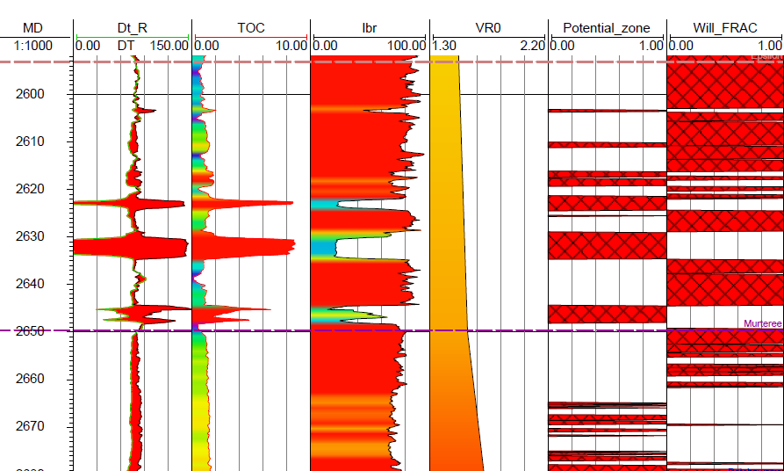
Well space - Geomechanical: Places for horizontal drilling to frac in potential zones
Criteria selections
Average brittleness >75 %
Drilling in brittle zone to frac in high potential zones
13
Outline
Shale plays
Basin potential
Well space characterisation
3D space characterisation
Reserves and uncertainty
Conclusion

Slide 15
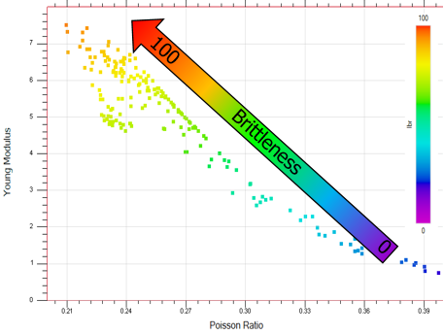
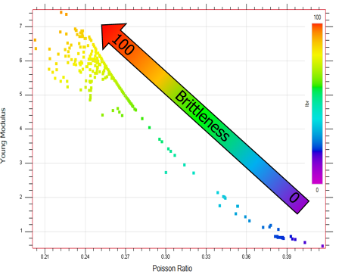
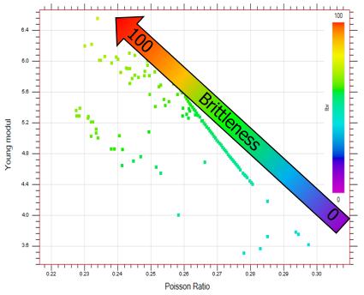
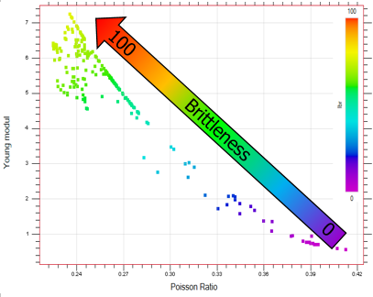
Well space – Rock Physics Analysis-Determination trends in geomechanical domains in according of brittleness
Murteree formation,Well-1
Epsilon formation,Well-1
Murteree formation,Well-2
Murteree formation,Well-2
14
Outline
Shale plays
Basin potential
Well space characterisation
3D space characterisation
Reserves and uncertainty
Conclusion

Slide 16
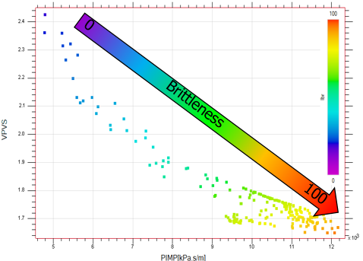
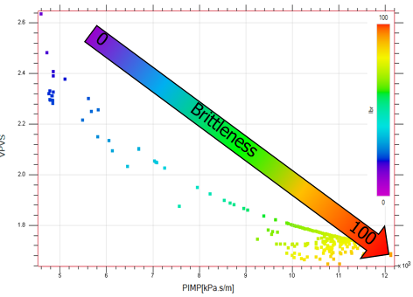
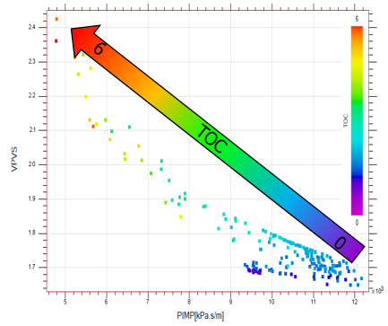
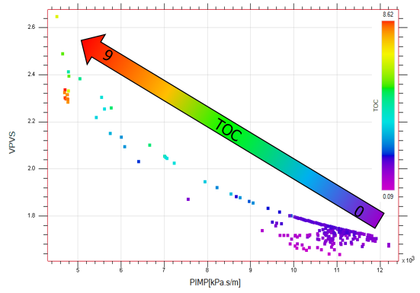
Well space – Rock Physics Analysis - Determination trends in elastic domain
Murteree formation,Well-1
Epsilon formation,Well-1
Murteree formation,Well-2
Murteree formation,Well-2
15
Outline
Shale plays
Basin potential
Well space characterisation
3D space characterisation
Reserves and uncertainty
Conclusion

Slide 17
3D space unconventional reservoir characterisation
3D Space Reservoir Characterisation
Geochemical
Geomechanical
Seismic
3D generation
Modeling, vitrinite reflectance
Seismic inversion,
P-impedance
Estimation Poisson ratio and Young modulus
If VR0>1
Yes
Brittleness analysis
Potential zone identification
Rock-physics
analysis
If Ibr > 75 %
Yes
Places for horizontal drilling to frac in potential zones
Reserves estimation and uncertainty analysis
Well logging data
Completion strategy determination
16
Outline
Shale plays
Basin potential
Well space characterisation
3D space characterisation
Reserves and uncertainty
Conclusion

Slide 18
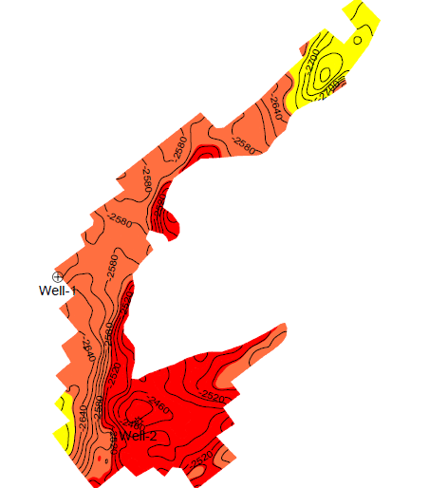


3D generation modeling, vitrinite reflectance
Epsilon Source TOC 4 %, Type Kerogen 2
Murteree Source TOC 3 %, Type Kerogen 2
Epsilon and Murteree surfaces
Input data:
Vitrinite map Epsilon Formation
Vitrinite map Murteree Formation
Murteree-Epsilon Formations are dry gas zone
17
Outline
Shale plays
Basin potential
Well space characterisation
3D space characterisation
Reserves and uncertainty
Conclusion

Slide 19




3D space – Rock Physics Analysis-Determination relation between p-impedance and brittleness
Murteree formation,
Well-1
Epsilon formation,
Well-1
18
Outline
Shale plays
Basin potential
Well space characterisation
3D space characterisation
Reserves and uncertainty
Conclusion

Slide 20





3D space – Seismic inversion
Case of presence angle gathers
Case of post-stack data
Well data
Angle Gathers
Horizons
Well 1 and Well 2
Sonic, density logs
Check shots
RP reflectivity
RS reflectivity
Epsilon(6 layers)
Murteree (Top, base) 3 layers
Wavelet
ZP impedance
ZS impedance
Seismic
λρ
µρρ
Model
Inversion
Post-stack survey
λρ vs. µρ crossplot
P-impedance
P-impedance 2D map
Epsilon Formation
P-impedance well correlation
19
Outline
Shale plays
Basin potential
Well space characterisation
3D space characterisation
Reserves and uncertainty
Conclusion

Slide 21




3D space – Brittleness analysis
In according of rock-physics analysis, P-impedance and Brittleness have good correlation (well space), that is why based on P-impedance result brittleness was estimated.
Average Brittleness 2D map
Epsilon Formation
Average brittleness well correlation
20
Outline
Shale plays
Basin potential
Well space characterisation
3D space characterisation
Reserves and uncertainty
Conclusion

Slide 22



3D space – Analysis of TOC – P-impedance and Average Brittleness
TOC 2D map
Epsilon Formation
P-impedance 2D map
Epsilon Formation
Average Brittleness 2D map
Epsilon Formation
21
Outline
Shale plays
Basin potential
Well space characterisation
3D space characterisation
Reserves and uncertainty
Conclusion

Slide 23



3D space – Sweet spot analysis
Reservoir Quality
Completion Quality
RQ & CQ
Good
Good
Good
Poor
Poor
Poor
21
Outline
Shale plays
Basin potential
Well space characterisation
3D space characterisation
Reserves and uncertainty
Conclusion

Slide 24

3D space – Completion strategy determination
22
Outline
Shale plays
Basin potential
Well space characterisation
3D space characterisation
Reserves and uncertainty
Conclusion

Slide 25



Integrated reservoir modeling- constriction static geological model and fluid model
Static geological model
Contact set for Murteree-Epsilon formations
Surfaces: Top Epsilon, Top Murteree, Base Murteree
Geometry: Grid increment Xinc=25 m, Yinc=25 m
Limitations: Surface boundaries
Parameters for probability reserves estimation
Variables | Minimal value | Base value | Maximum value
Porosity | 0,05 | 0,075 | 0,12
Net to Gross | 0,7 | 0,8 | 0,9
Gas formation volume factor | 1 | 1,1 | 1,2
Gas recovery factor | 0,2 | 0,25 | 0,3
23
Outline
Shale plays
Basin potential
Well space characterisation
3D space characterisation
Reserves and uncertainty
Conclusion

Slide 26



Reserves and uncertainty analysis – Epsilon formation
2.7
0.6
1.0
4.1
1.6
5.5
Spearman rank correlation
Porosity (47,32 %)
Gas recovery factor(22,14 %)
Bg(15,45 %)
Net to gross(15,09 %)
24
Outline
Shale plays
Basin potential
Well space characterisation
3D space characterisation
Reserves and uncertainty
Conclusion

Slide 27

Reserves and uncertainty analysis – Murteree formation
0.8
3.6
1.3
5.3
2
7.2
Spearman rank correlation
Porosity (46,45 %)
Gas recovery factor(29,2 %)
Bg (15,53 %)
Net to gross(13,83 %)
25
Outline
Shale plays
Basin potential
Well space characterisation
3D space characterisation
Reserves and uncertainty
Conclusion

Slide 28
Conclusion
Studied method and made initial evaluation about basin potential
Studied difference between unconventional and conventional pores systems
The integration approach was developed which, allow making following things:
characterize reservoir through brittle and maturity view
identify hydrocarbons zones
evaluate recoverable factor based on brittleness and geological complexity
make completion strategy based on brittleness
identify zones for horizontal drilling
evaluate volume of proppant for fracturing
make complex evaluation about perspective of selected formations
Future opportunities
Adding investigation of fractures geometries by seismic interpretation
Adding seismofacies description and correlation them with TOC and brittleness
Trying to combine multifocusing method and fracture geometry description
25
Outline
Shale plays
Basin potential
Well space characterisation
3D space characterisation
Reserves and uncertainty
Conclusion

Slide 29
Shale oil and gas reservoir characterisation
Thank you !
!شكر
Giza, Egypt, 2 September 2015

